Slide 1
Development of a Symbolic Regression-Based Model for Leading Edge of Film Cooled Gas Turbine Blade

Slide 2
Project Workflow
3D CAD Geometry
Meshing Methodology
CFD Validation
Parametric Geometry Design
Results
Parameter Selection and Parameter
Ranges
Model Training
(Symbolic Regression)
Model Testing & Comparison with CFD Results

Slide 3
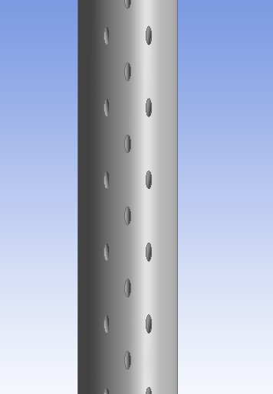
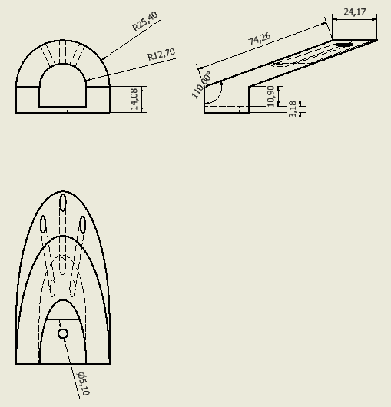
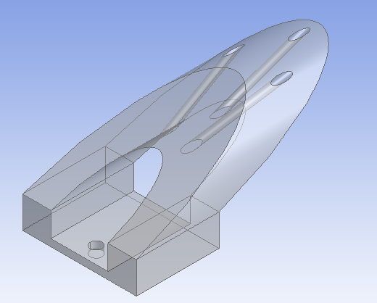
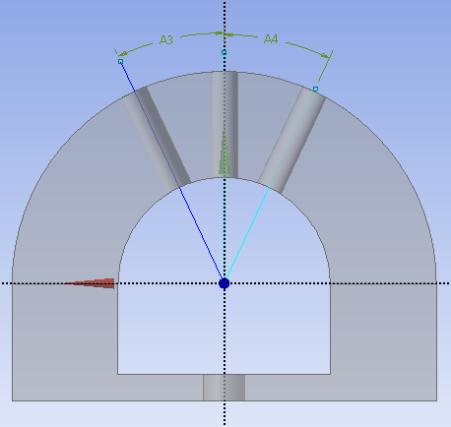

3D CAD Geometry
The validation is based on the study “Overall Effectiveness for a Film-Cooled Turbine Blade Leading Edge With Varying Hole Pitch. ”
The geometry was designed to enable periodic analysis, since the paper does not specify the number of holes.
$$25°$$
K = 1.04 ± 0.06 W/m.K (Polycast 287)

Slide 4
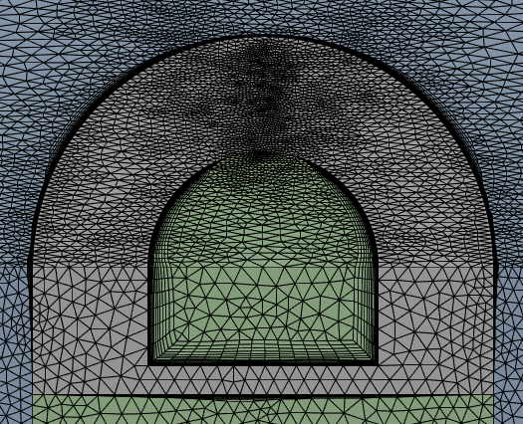
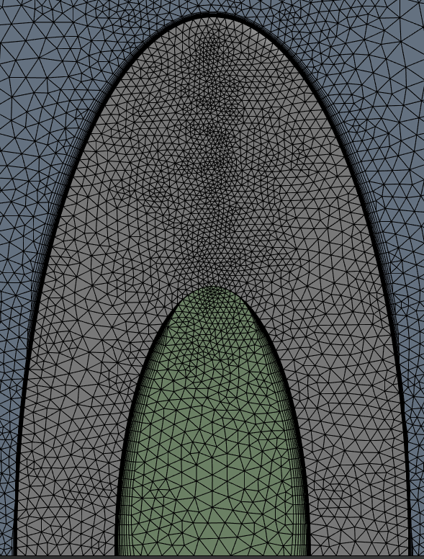
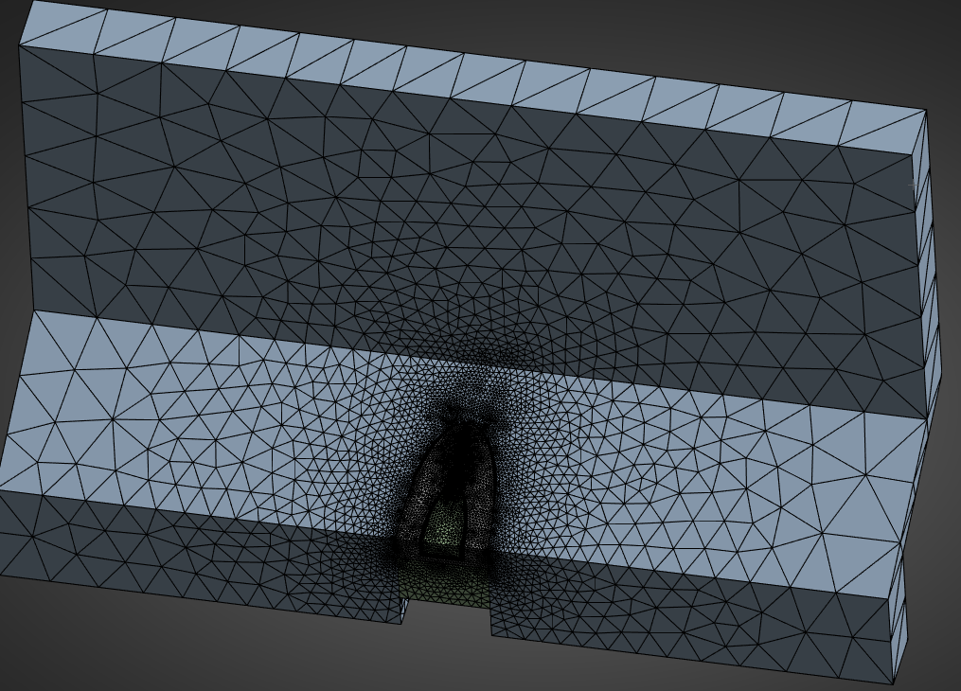
Meshing
View from top

Slide 5

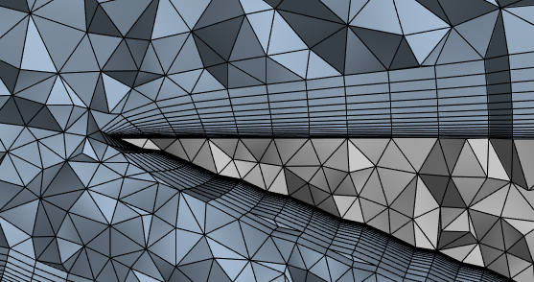
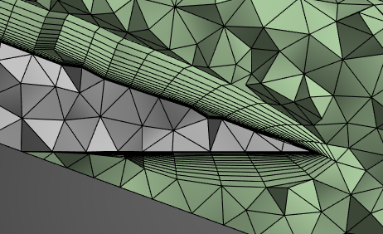
Fluid Domain
Solid
Fluid Domain
Fluid Domain
Solid
Solid

Slide 6
Boundary Conditions
Mainstream velocity was maintained at a nominal value of 15 m/s.
Tu levels measured at 5%, with a turbulence length scale of 2.3 cm at the location of the model
Typical 𝑇∞ values were near 300 K. The coolant was simulated using N₂​ gas at 200 K in order to maintain a constant DR of 1.5 for all test conditions.
The cold gas then passed through a plenum which served to evenly distribute the gas along the span of the model.
turbulence effects were modeled with the Realizable k–ε and Menter SST k–ω approaches
(Blowing ratio ) M = 2

Slide 7
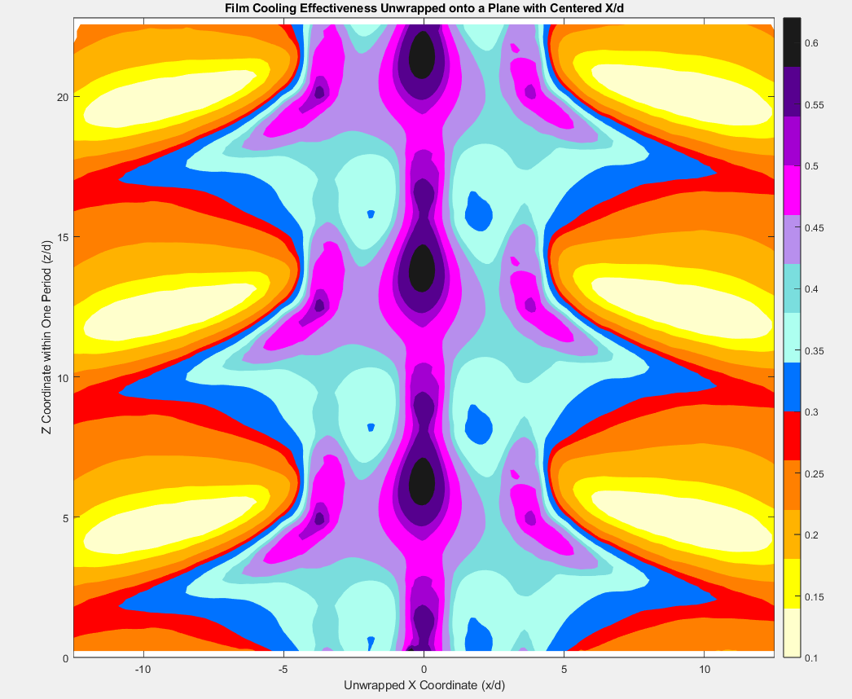
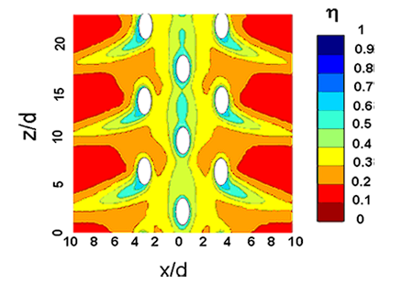
Results
CFD
Experiment

Slide 8
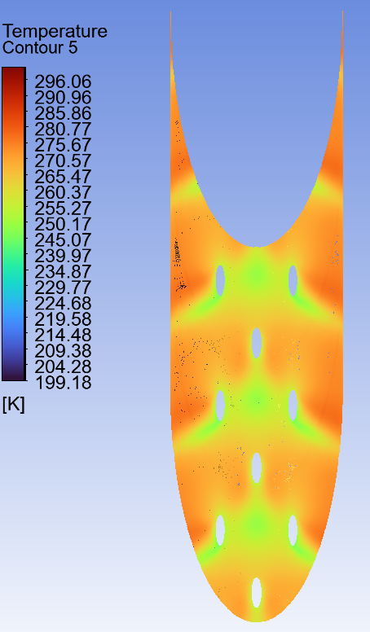
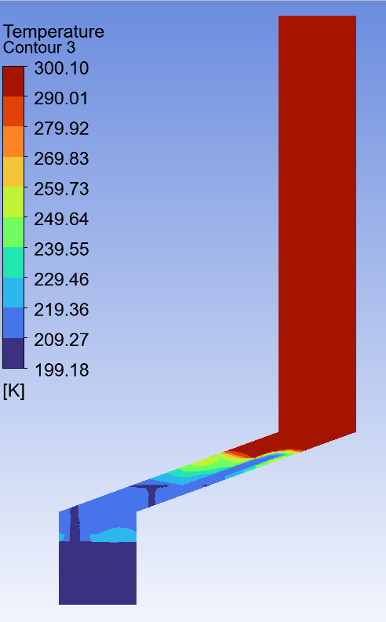
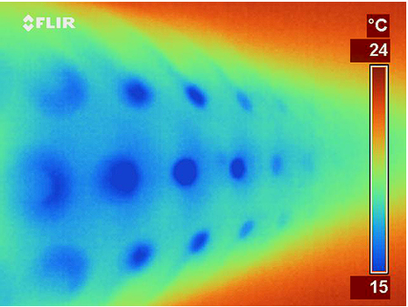

Slide 9
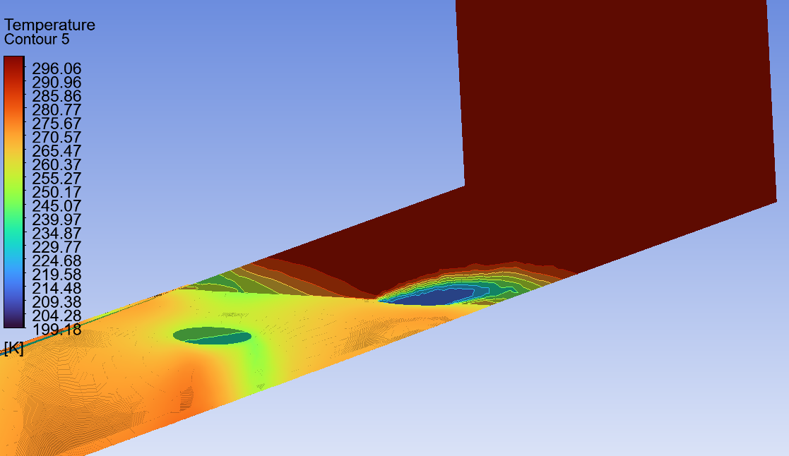
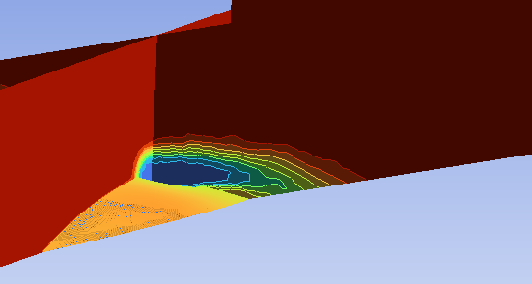

Slide 10
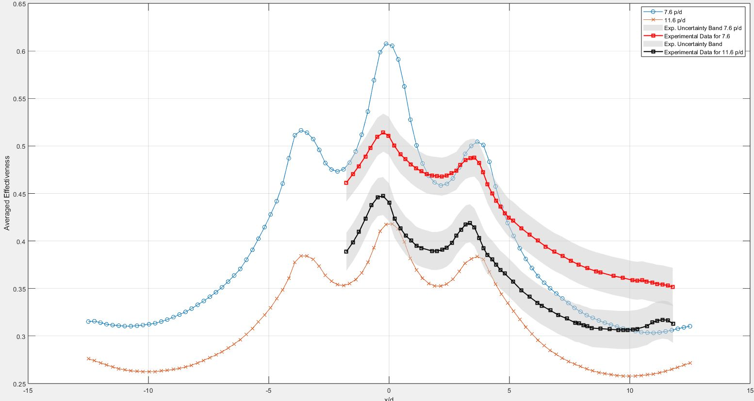

Slide 11
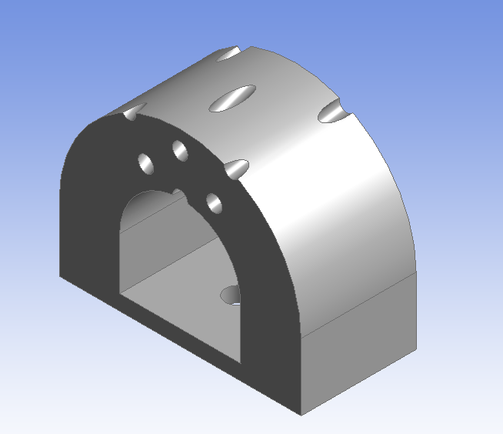
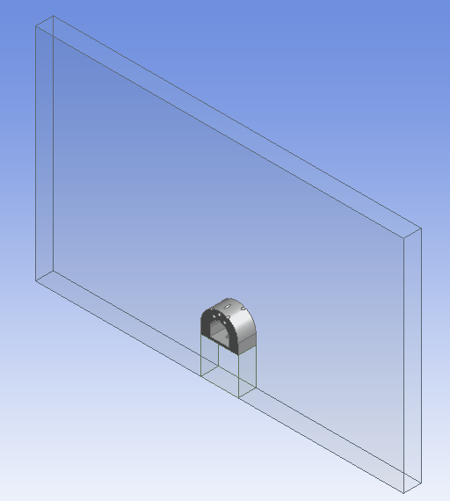
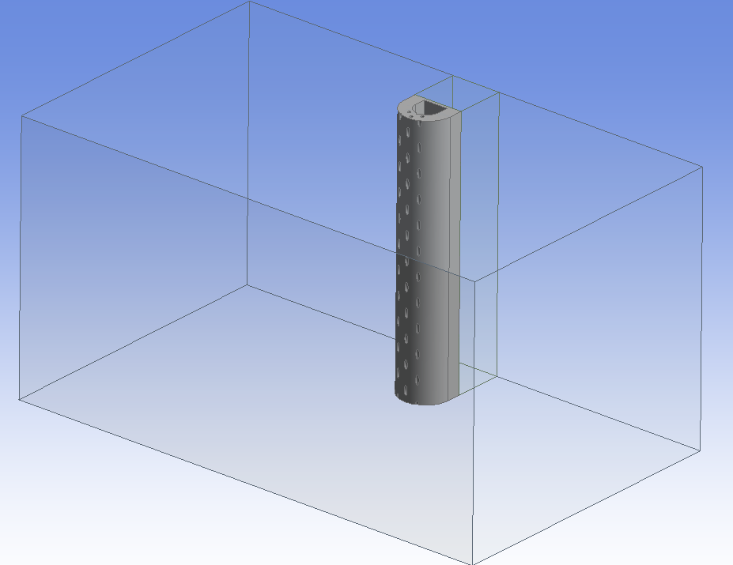
Parametric Study
Mainstream Inlet
Translational Periodicity
Outlet
Coolant Inlet

Slide 12
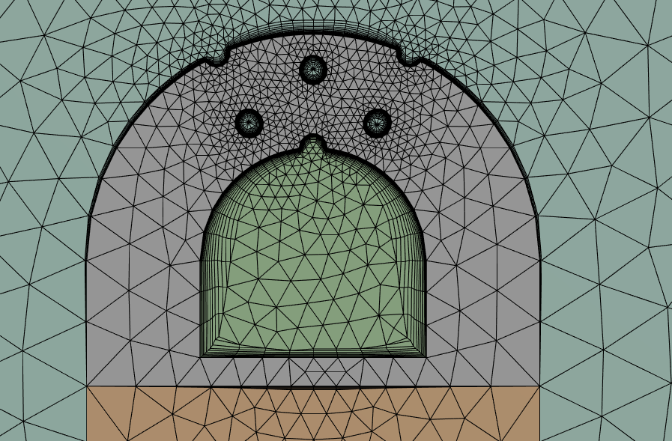

Meshing For Parametric Geometry
View From Front
View From inside of the Geometry

Slide 13

Design variable | Symbol | Unit | Lower bound | Upper bound
Cooling Hole Diameter | D | mm | 2 | 6
Pitch | P | mm | 22 | 50
Impingement Hole Diameter | ID | mm | 3 | 12
Side Hole Angle | ∅ | ° | 15 | 70
Cooling Hole Diameter
Side Hole Angle
Pitch
Impingement Hole

Slide 14
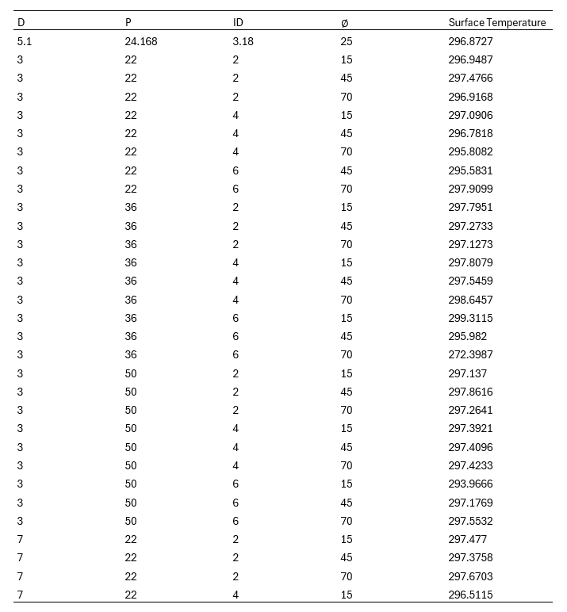
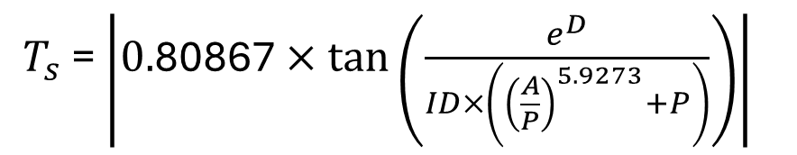
Training Samples
The dataset consisting of these samples was utilized to train the symbolic regression-based mathematical model.
These are only the first 31 samples. In total, there are 79 samples.
The model was built in Python using the PySR library.
$T_{s}$= $\left|0.\text{80867}×tan\left(\frac{e^{D}}{ID×\left({\left(\frac{A}{P}\right)}^{5.9273}+P\right)}\right)\right|$

Slide 15
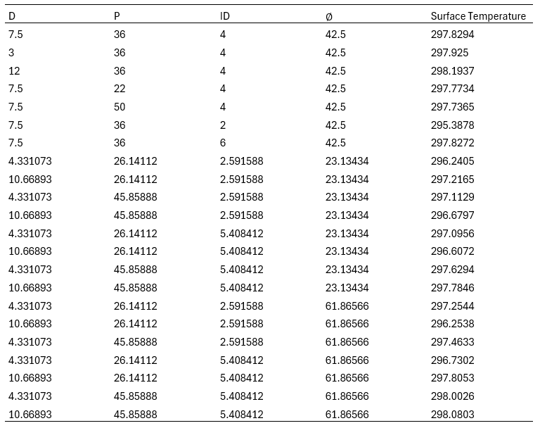
Testing Samples
Testing samples were used to compare the CFD results with the model predictions obtained from the training samples.

Slide 16
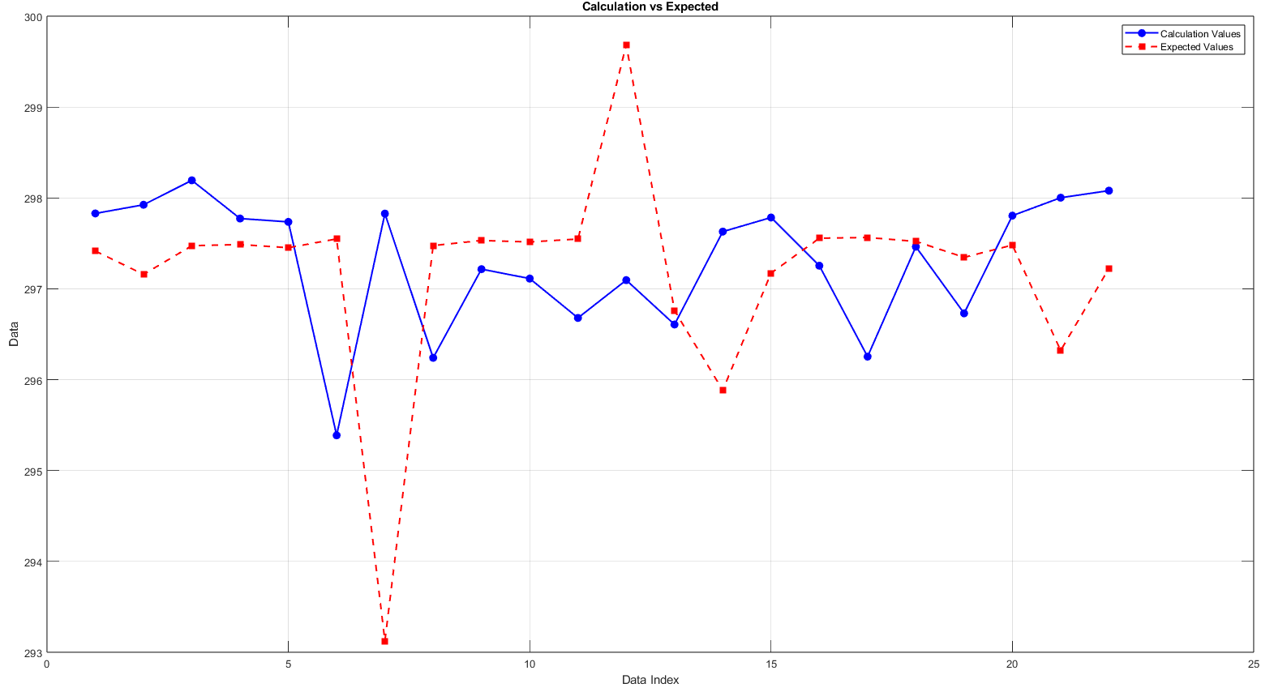

Slide 17
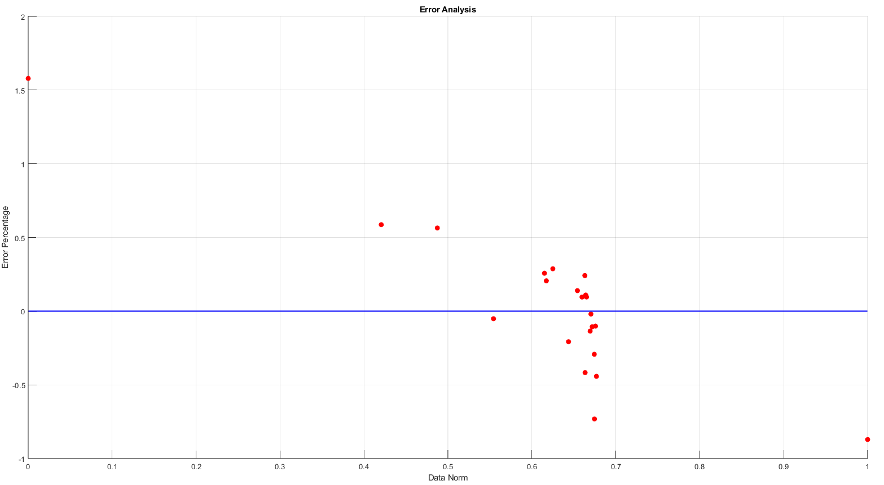

Slide 18
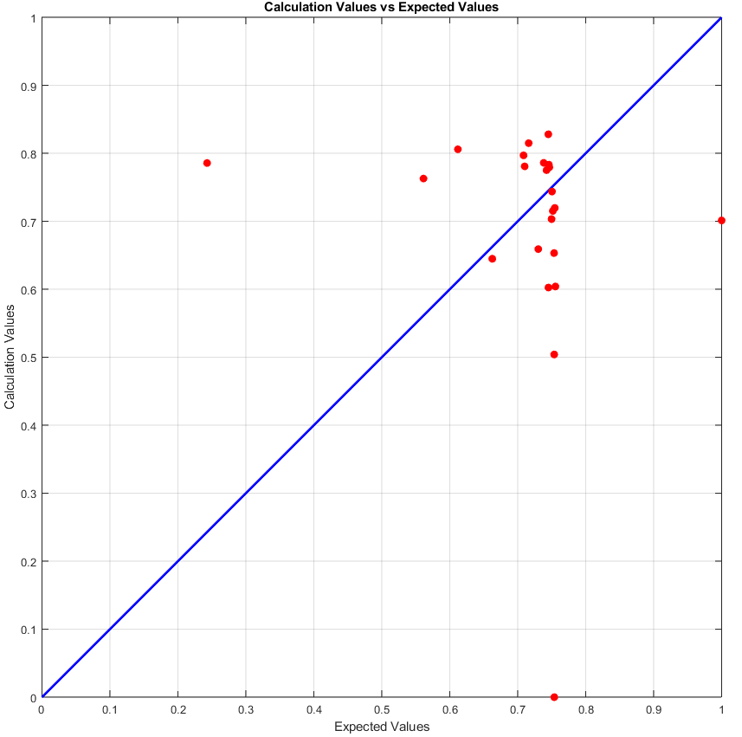
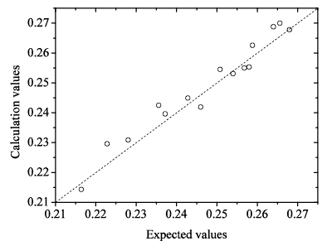
The graph did not turn out as expected. I aimed for a result similar to the example below, but it did not work as intended. Although I would like to continue working on this project, I currently do not have enough time. I plan to complete it after my internship.
Example

